Slide 1
IMPROVEd SOURCE OF DRINKING WATER
IBM SKILLUP PROJECT
Presented By:
1. SHAIK MAHAMMAD SIDDIQ - BHARATH UNIVERSITY - ECE

Slide 2
OUTLINE
Problem Statement (Should not include solution)
Proposed System/Solution
System Development Approach (Technology Used)
Algorithm & Deployment
Result (Output Image)
Conclusion
Future Scope
References

Slide 3
Problem Statement
Example: The core problem is a lack of access to consistently safe and reliable drinking water sources, despite the existence of technologies and infrastructure improvements. While "improved" water sources like piped water, boreholes, and protected wells are more likely to be free from contamination, they don't guarantee water safety. Furthermore, even with improved sources, factors like accessibility, availability, and potential for contamination during distribution or storage can still compromise water quality and pose health risks.

Slide 4
Proposed Solution
Improved sources of drinking water are those that are protected from contamination, primarily from fecal matter. These include piped water (into dwellings, yards, or public taps), boreholes, protected dug wells, protected springs, and rainwater collection. Unimproved sources, on the other hand, include unprotected wells, springs, surface water, and bottled water (if not accompanied by an improved source).

Slide 5
System Approach
An improved source of drinking water system approach focuses on providing access to water sources that are less susceptible to contamination compared to unimproved sources. These sources include piped water into the dwelling, public standpipes, boreholes, protected dug wells, protected springs, and rainwater collection. Improved sources aim to reduce the risk of waterborne diseases by minimizing exposure to fecal matter and other contaminants.

Slide 6
Algorithm & Deployment
Improved sources of drinking water are those that are protected from contamination, particularly fecal matter. These sources include piped water connections, public taps or standpipes, tube wells or boreholes, protected dug wells, protected springs, and rainwater collection. The deployment of these sources often involves community engagement, infrastructure development, and ongoing monitoring to ensure sustainability and effectiveness.

Slide 7
Result
Improved sources of drinking water, such as household connections, public standpipes, and protected wells, significantly reduce the risk of waterborne diseases and improve overall health outcomes. Access to these improved sources can lead to economic benefits by reducing time spent collecting water and healthcare costs associated with waterborne illnesses. Children, in particular, benefit from improved water sources through better health, leading to increased school attendance and positive long-term consequences.

Slide 8
Conclusion
Improved sources of drinking water, such as piped connections and protected wells, lead to significant public health, social, and economic benefits. These benefits include reduced incidence of waterborne illnesses, increased productivity due to time savings in water collection, and positive impacts on education and overall well-being.

Slide 9
Future scope
Improved drinking water sources, like piped water and protected wells, are crucial for public health and sustainable development. Future scope involves expanding access to these improved sources, particularly in underserved areas, and ensuring water quality through comprehensive risk management approaches like Water Safety Plans. This includes addressing challenges like water scarcity, pollution, and the impacts of climate change, while also promoting innovation, private sector participation, and behavior change.

Slide 10
References
Improved sources of drinking water are those designed and constructed to be protected from outside contamination, especially from fecal matter. These sources include piped water (into a dwelling, yard, or plot), public tap/standpipe, tube well/borehole, protected dug well, protected spring, and rainwater collection. Essentially, they are designed to deliver safe water by their nature.

Slide 11
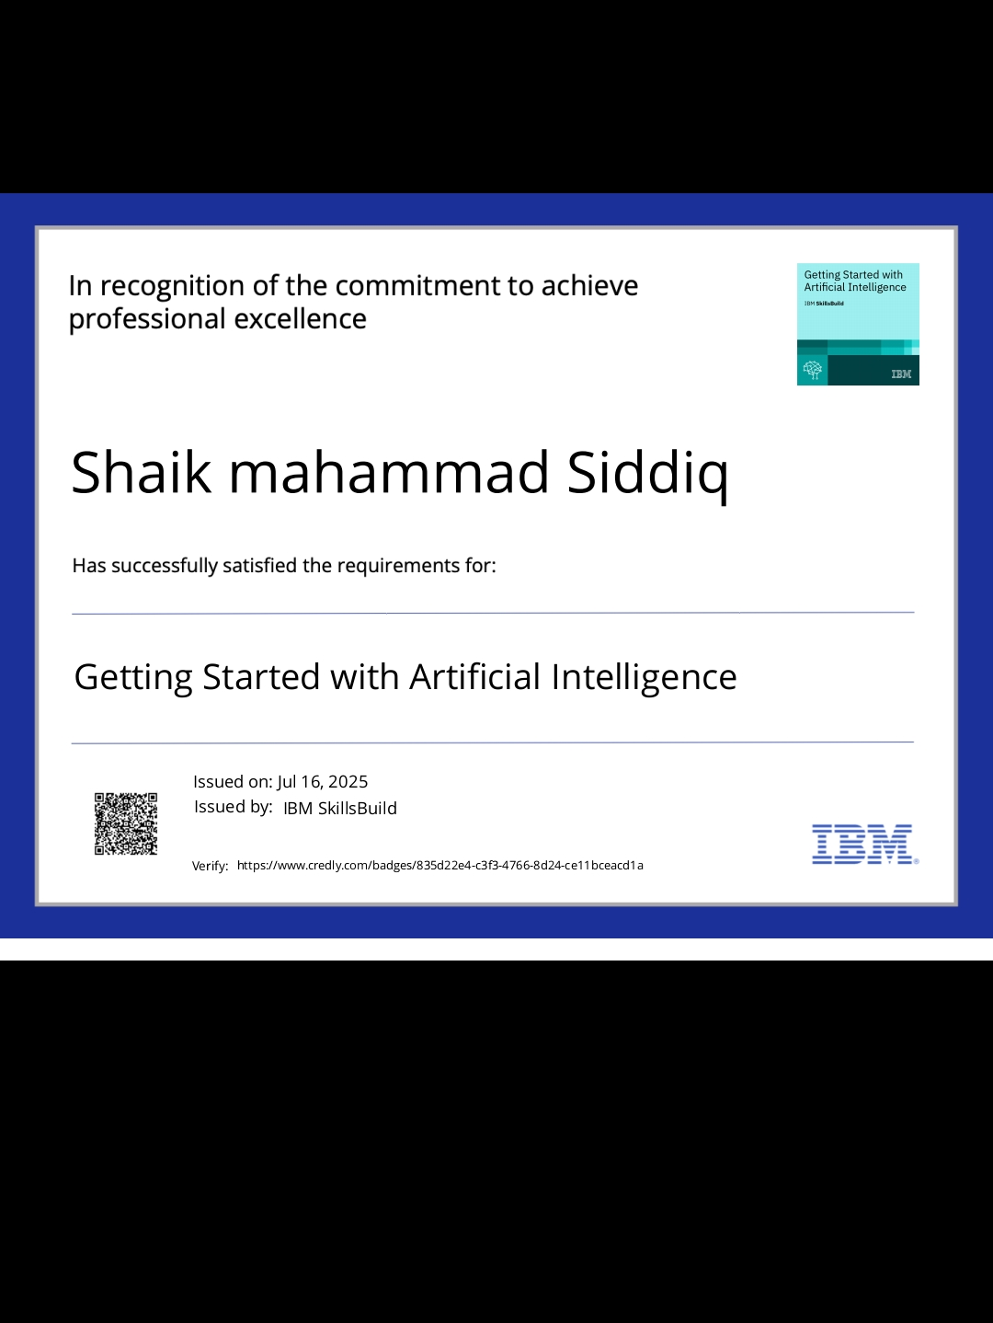
IBM Certifications Screenshot/ credly certificate( getting started with AI

Slide 12
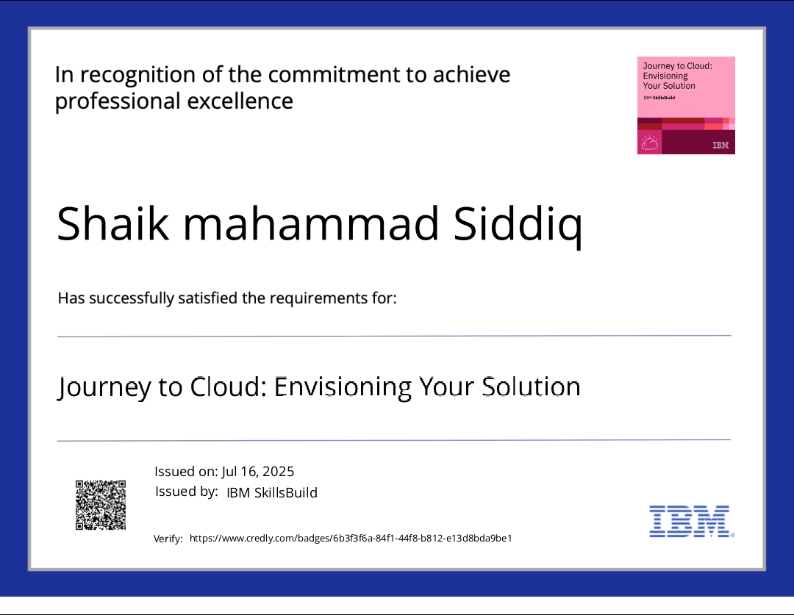
IBM Certifications Screenshot/ credly certificate( Journey to Cloud

Slide 13
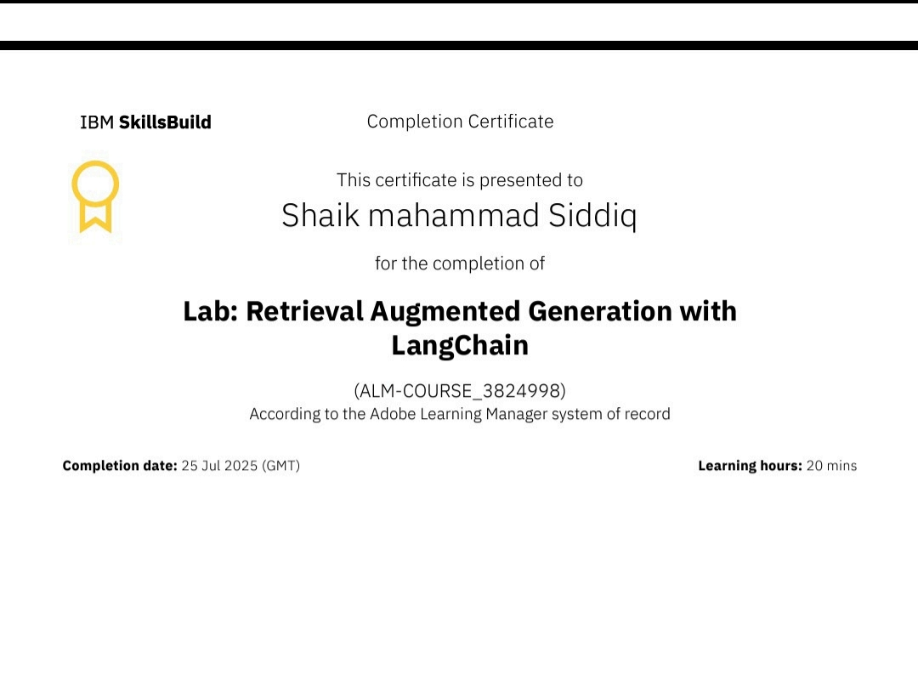
IBM Certifications Screenshot/ credly certificate( RAG Lab)

Slide 14
GITHUB LINK:-
https://github.com/shaiksiddiq8247/IBM-SKILLUP.git

Slide 15
THANK YOU

